Slide 1

Ecommerce: Amazon case study
Work Hard. Have Fun. Make History
Vijay Tiwari
03/03/2024

Slide 2
Problem Statement
You are working as a business analyst at Amazon, a company currently performing well. The stakeholders wish to maintain this level of performance and seek improvement. For this purpose, they want to devise new strategies. You are part of a team exploring new ways to benefit customers, such as offering more discounts and Prime membership perks. Could you suggest additional methods to identify and reward customers and enhance their shopping experience?

Slide 3
Null Values: Everything depends on data . To analysis the trends of sale by deep dive on data where and why underperforming sale . What if data itself not correct and final result misguide .
Problems
Returned Products: To get prime reason behind 31K product Returned after delivery . Is it defective product or customer satisfaction compromises?
Contradiction : Some products have high prices and still underperform in sales

Slide 4
Challenges deep-dive
Challenge 1
Challenge 2
Challenge 3
Loyalty Program
Designing a program aimed at retaining existing customers without compromising their benefits, ensuring that the longer they remain, the greater the advantages they receive.
Discounts
Which products warrant discounts? Consider scenarios where products with low sales may be affected by factors beyond pricing, rendering discounts ineffective in boosting sales.
Management/Schedule
Electronic items often experience longer waiting periods for delivery, even if they are not frequently shipped from abroad, whereas fashion items typically have shorter waiting periods.

Slide 5
Solution 1
Loyalty programs should feature distinct tiers with rewards that transition smoothly as members progress.
For instance, when a member upgrades from Iron to Bronze, they retain all Iron benefits while gaining additional perks specific to Bronze, except for discount rates.
This strategy ensures customer retention, fosters passive growth, and enhances overall satisfaction.
Loyalty Program
Iron, Bronze, Diamond, Silver, Gold, Platinum, Ascendant, Immortal.

Slide 6
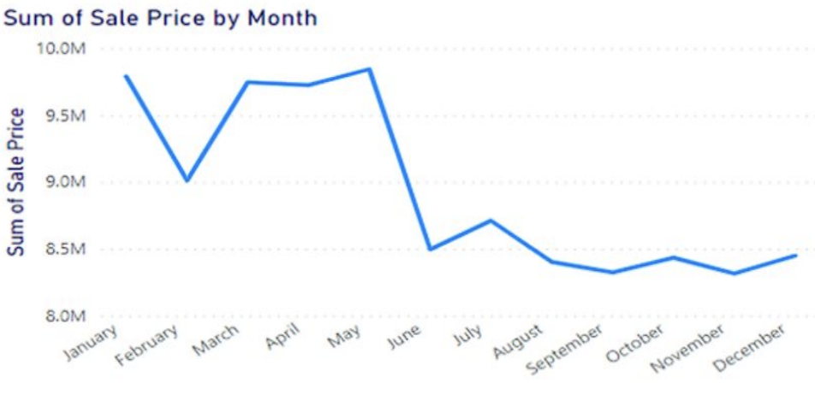
Solution 2
Discounts based on months/festives.
we identified the products that would benefit most from these discounts.
After visualizing the data and addressing null values, it became apparent that discounts are needed during the months from August to December to counteract decreased sales.

Slide 7
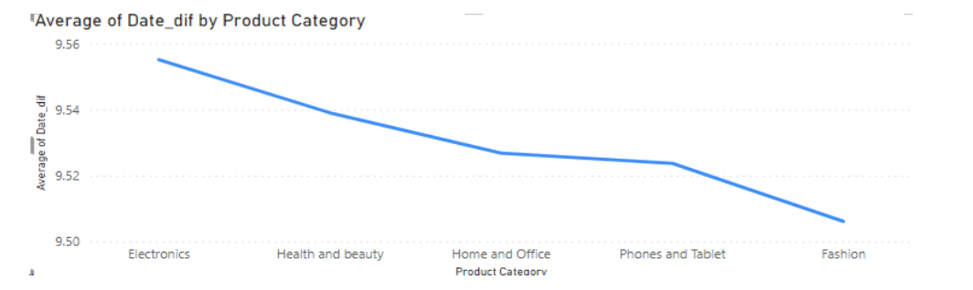
Management /
Scheduling
The graph illustrates that fashion products generally have shorter waiting times compared to electronics products. To optimize staffing, we can train employees to handle various product categories, allowing flexibility for staff to assist where needed, especially during peak times for electronics products.

Slide 8
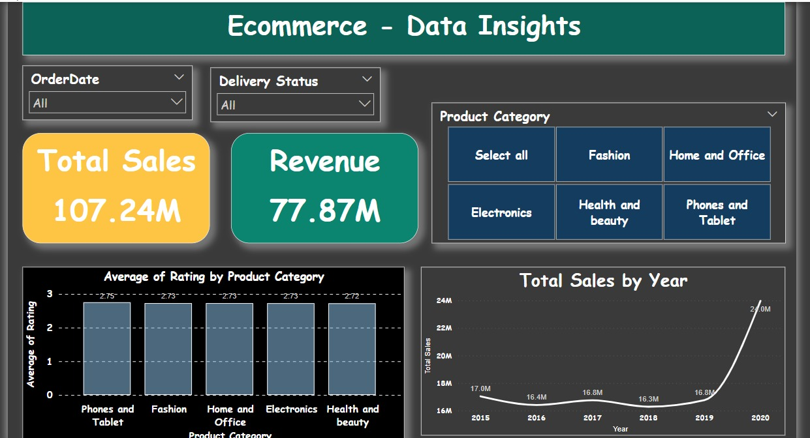
The Main tab in the report should provide stakeholders with an overview of total sales, revenue generated to date, and customer satisfaction across all product categories. This tab should include a slicer allowing stakeholders to filter by product category and date for deeper analysis and insights.

Slide 9
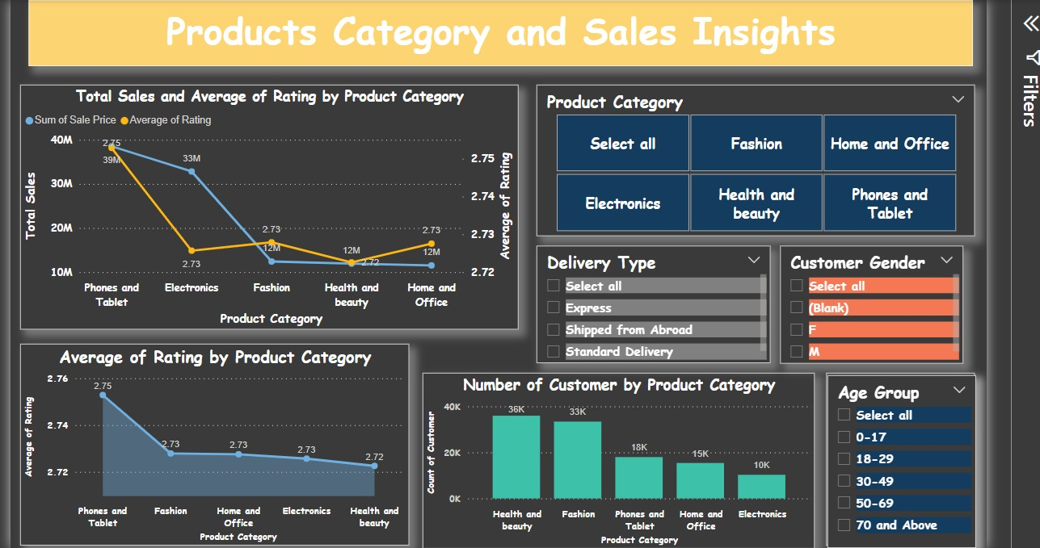
The Product Tab should enable company management to assess the performance of individual product categories, including customer satisfaction, the number of customers purchasing each product, and areas needing improvement. This tab should feature slicers allowing filtering by gender, delivery type, product category, and age group to facilitate detailed analysis and targeted decision-making.

Slide 10
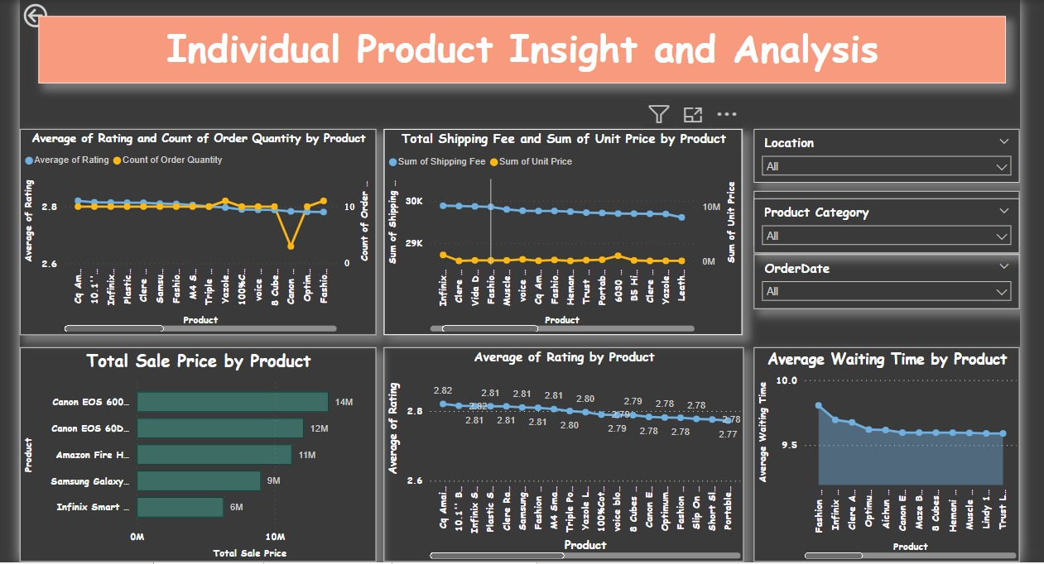
In the Individual Product Tab, company management and stakeholders aim to analyze the best product profiles based on various metrics. This includes the total purchases, product ID, category/subcategory, average rating, and revenue generated by each product. These metrics provide valuable insights for carefully addressing each product in their orders and making informed decisions.

Slide 11
Summary analysis: key factors Himani Tea- Canon dslr 18mp camblack
Total product sales
Product with least wait time
Product with most sales
77.87M
31K
Fashion Boys Sneaker
Himani Tea-8 Bags
Canon dslr 18mp camblack
Total returned products
Product with least sales

Slide 12

Thanks!

